Slide 1
BRVM Dialogue with International Investors
London, May 02nd 2018
Dr. Edoh Kossi AMENOUNVE
Chief Executive Officer of BRVM & DC/BR
Chairman of West African Capital Markets Integration Council (WACMIC)
Executive Committee African Securities Exchanges Association (ASEA)

Slide 2
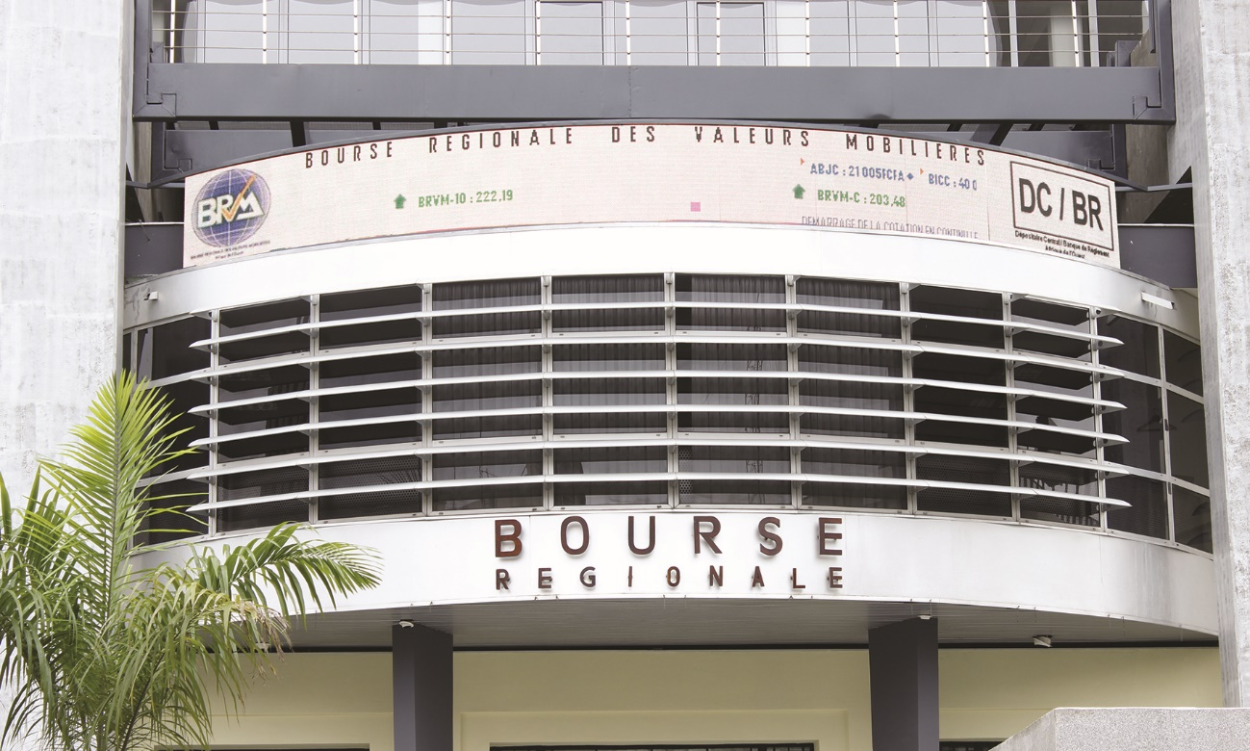
Regional Stock Exchange
The BOURSE REGIONALE DES VALEURS MOBILIERES (BRVM) is a fully integrated and electronic regional stock exchange common to 8 countries in West Africa: Benin, Burkina Faso, Cote d’Ivoire, Guinea-Bissau, Mali, Niger, Senegal and Togo.
It is the 6th African stock exchange in terms of market capitalization, and has 45 listed companies (May 2018) in the following sectors : transportation, industry, finance, public utilities, agriculture, distribution and others.
BRVM is an executive member of the African Securities Exchanges Association (ASEA) and currently chairs the West African Capital Market Integration Council (WACMIC).

Slide 3
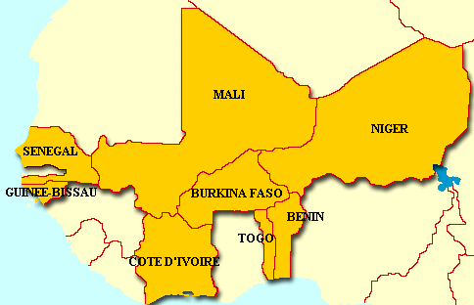
WAEMU * | 2015 | 2016 | 2017p | 2018p
Real GDP | +6% | +6.2% | +6.5% | +6.4%
Nominal GDP (XOF bn.) | 51,573 ($92.1 bn.) | 55,874 ($99.8 bn.) | 60,773 ($108.5 bn.) | 66,023 ($117.9 bn.)
Inflation | 1.5% | 1.8% | 1.9% | 2%
Total investment (% GDP) | 22.8% | 23.3% | 23.3% | 23.6%
FDI (% GDP) | 2.7% | 3.1% | 3.4% | 3.8%
Gross national savings (% GDP) | 15.5% | 16.4% | 16.5% | 16.8%
A favorable macroeconomic environment …
Mali
Population 2017 : 23.37 million
Nominal GDP 2017 : XOF 7,491 bn. (USD 13.38 bn.)
Real GDP 2017 : + 5.3%
Inflation 2017 : 0.2%
Total investment 2017 (% GDP): 35.9%
FDI 2017 (% GDP): 0,89%
Gross national savings 2017 (% GDP): 30.7%
Senegal
Population 2017 : 15.73 million
Nominal GDP 2017 : XOF 9,528 bn. (USD 17.01 bn.)
Real GDP 2017: + 6.8%
Inflation 2017 : + 1.9%
Total investment 2017 (% GDP): 27.4%
FDI 2017 (% GDP): 3%
Gross national savings 2017(% GDP): 20.5%
Niger
Population 2017 : 21.5 million
Nominal GDP 2017 : XOF 4,418.4 bn.(USD 7.9bn.)
Real GDP 2017 : + 5.2%
Inflation 2017 :+ 2.0%
Total investment 2015 (% GDP): 42.1%
FDI 2017 (% GDP): 5.8%
Gross national savings 2017 (% GDP): 23.70%
Mali
Guinea Bissau
Population 2017 : 1.83 million Nominal GDP 2017 : XOF 780.70 bn. (USD 1.39 bn.)
Real GDP 2017 : + 5.9%
Inflation 2017 : + 2%
Total investment 2017 (% GDP): 11.1%
FDI 2017 (% GDP): 1.7%
Gross national savings 2017(% GDP): 7.8%
Benin
Population 2017: 11.1 million
Nominal GDP 2017 : XOF 5,390 bn. (USD 9.3 bn.)
Real GDP 2017 : + 5.4%
Inflation 2017 : +2%
Total investment 2017(% GDP): 28.6%
FDI 2017 (% GDP): 4.6%
Gross national savings 2017 (% GDP): 19.4%
Côte d’Ivoire
Population 2017 : 25 million
Nominal GDP 2017 : XOF 22 505 bn.(USD 40.2 bn.)
Real GDP 2017 : + 8.1%
Inflation 2017 : + 1.5%
Total investment 2017 (% GDP): 19.9%
FDI 2017 (% GDP): 3.3%
Gross national savings 2017 (% GDP): 17.3%
Togo
Population 2017 : 7.35 million Nominal GDP 2017 : XOF 2,812 bn. (USD 5.02 bn.)
Real GDP 2017 : + 5.3%
Inflation 2017 : +1.5%
Total investment 2017(% GDP): 26.1%
FDI 2017 (% GDP): 5.2%
Gross national savings 2017 (% GDP): 17.1%
Burkina Faso
Population 2017: 19.63 million
Nominal GDP 2017 : XOF 7,587 bn. (USD 13.1 bn.)
Real GDP 2017 : + 6.4%
Inflation 2017 : +1.5%
Total investment 2017 (% GDP): 16.3%
FDI 2017 (% GDP): 2.6%
Gross national savings 2017 (% GDP): 9.2%
Source: IMF , World Bank Group,
BCEAO (Central Bank)
* WAEMU : West African Economic and Monetary Union

Slide 4
Stock Exchange with a unique profile…
Started operating in September 1998
Fully electronic stock exchange, compliant with international standards
Common stock exchange for the 8 countries of the West African Economic and Monetary Union (WAEMU) : Benin, Burkina Faso, Côte d’Ivoire, Guinea Bissau, Mali, Niger, Senegal and Togo
Only single unified, fully-integrated regional stock exchange in the world
Successful political, institutional and technical capital market integration
Demutualized stock exchange
Has a settlement guarantee fund to mitigate settlement risk
Mali
Listed company : 1
Brokerage firms : 1
Niger
Listed company: 1
Brokerage firms : 1
Senegal
Listed companies : 3
Brokerage firms : 4
Custodian : 3
Côte d’Ivoire
Listed companies : 35
Brokerage firms : 15
Custodians : 5
Burkina Faso
Listed companies: 3
Brokerage firms : 2
Togo
Listed company : 1
Brokerage firms : 1
Benin
Listed company : 1
Brokerage firms : 5
45 Listed companies
37 Listed bonds

Slide 5
A favorable market to regional and foreign investors …
Single financial market regulator (CREPMF)
IOSCO member
No restriction on opening securities account in the 8 countries.
A single regulatory framework modeled on international standards
Investor protection provided
Reporting of foreign currency used to invest in the stock market to facilitate outflows (*)
Single commercial law for 8 countries (WAEMU region)
Electronic Stock Exchange (BRVM)
No restriction on holdings of listed securities by foreign investors
Trading hours spanning international time zones for investors (9h – 15 h GMT).
Continuous trading.
11%
Mandatory threshold crossing declarations (10%; 20%; 33.33%; 50% and 66.66%).
Integration of BRVM in MSCI and S & P indices
Free repatriation of income (dividends, interest, etc.) from securities investments (*).
Market information available on Bloomberg in real-time
Single Central Depository (DC/BR)
A banking network with 118 commercial banks including subsidiaries of large international banks such as Societe Generale, BNP PARIBAS, Standard Chartered, Citi, UBA, etc.
ANNA and AMEDA member
97%
8 custodian banks (subsidiaries of international banks)
Use of a common currency, FCFA (XOF) pegged to the Euro at fixed parity. Use RTGS of BCEAO.
Settlement at T+3
Settlement guarantee fund to ensure the effective completion of transactions
(*) Regulation N°. 09/2010 / CM / UEMOA / on the External Financial Relations of the Member States of the West African Economic and Monetary Union (WAEMU)

Slide 6
BRVM key figures…
BRVM 10 & BRVM Composite Indexes
(2008-2017)
Sectors Indices
(2017)
BRVM C:
-16,81 %
+19,9%
+39,3%
+11,2%
+17,8%
Finance
Public Sector
Agriculture
Transport
Industry
Distribution
others
Sectors
-3,9%
+52,68 %
(2012-2017)
+61,84 %
(2012-2017)
-54,01 %
(2012-2017)
+244,82 %
(2012-2017)
-9,8%
BRVM 10
-16,15 %
+8,83 %
(2012-2017)
+93,24 %
(2012-2017)
+114,18 %
(2012-2017)
Market Cap: Equity market
(2008–2017)
Market Cap: Bond market
(2008-2017)
-11,29 %
+18,34 %
+91,17%
Market cap > 4,000 bn FCFA ($ 7,14 bn)
31 dec 2012
Market cap > 6,000 bn FCFA ($ 10.71 bn)
29 janv 2014
+256,97%
+2,7%
Market Cap
> 1,000 bn FCFA ($ 1.78 bn) 18 avril 2013
+58,9%
Market cap > 7,000 bn FCFA ($12.5 bn)
9 juillet 2015
Market cap > 5,000 bn FCFA ($8.93 bn)
27 mai 2013

Slide 7
FOCUS | BRVM’s IPO since 1998
FOCUS: BRVM IPOs since 1998…
IPO year | Company Name | IPO Amount ( FCFA) | IPO Date | Market Cap as of first trading day(FCFA) | Market Cap as of 31 December 31st 2017 | Variation
1998 | SONATEL | 34 436 500 000 | 02/10/1998 | 220 000 000 000 | 2 350 000 000 000 | 968,18%
1999 | SIVOA (AIR LIQUIDE) | 1 109 400 000 | 19/04/1999 | 8 729 633 000 | 3 493 600 000 | -59,98%
1999 | NEI | 435 500 000 | 14/04/2000 | 2 010 000 000 | 472 335 525 | -76,50%
1999 | PALMCI | 6 240 000 000 | 18/10/1999 | 32 000 000 000 | 85 026 238 000 | 165,71%
1999 | SERVAIR | 822 528 000 | 31/03/2000 | 2 764 800 000 | 21 824 000 000 | 689,35%
2000 | BOA BENIN | 1 680 000 000 | 17/11/2000 | 12 610 500 000 | 150 082 932 000 | 1090,14%
2003 | BOA NIGER | 346 005 000 | 30/12/2003 | 3 000 750 000 | 64 350 000 000 | 2044,46%
2009 | ONATEL BF | 30 600 000 000 | 30/04/2009 | 162 860 000 000 | 325 040 000 000 | 99,58%
2010 | BOA Côte d'Ivoire | 2 760 000 000 | 07/04/2010 | 17 139 000 000 | 98 000 000 000 | 471,80%
2010 | BOA Burkina F. | 2 300 000 000 | 30/12/2010 | 19 995 500 000 | 157 300 000 000 | 686,68%
2014 | Total Sénégal | 3 480 000 000 | 20/02/2015 | 42 025 233 000 | 61 897 630 000 | 47,29%
2014 | BOA Sénégal | 5 850 000 000 | 10/12/2014 | 38 700 000 000 | 60 000 000 000 | 55,04%
2016 | BOA MALI | 8 790 000 000 | 31/05/2016 | 49 821 100 000 | 80 340 000 000 | 61,26%
2016 | SIB | 26 146 000 000 | 27/10/2016 | 150 500 000 000 | 170 000 000 000 | 12,96%
2016 | CORIS | 36 750 000 000 | 23/12/2016 | 201 562 500 000 | 320 000 000 000 | 58,76%
2016 | SUCRIVOIRE | 14 651 000 000 | 28/12/2016 | 68 477 500 000 | 22 344 000 000 | -67,37%
2017 | NSIA BANQUE | 34 539 525 000 | 24/10/2017 | 224 169 750 000 | 223 822 200 000 | -0,16%
2017 | ECOBANK CI | 45 000 000 000 | 12/12/2017 | 236 717 580 000 | 326 780 361 600 | 38,05%
TOTAL |  | 255 936 458 000
175,21 billions FCFA ($312.87 millions) raised via IPO in the WAMU region since 2014, with an average of 2 IPOs per year.

Slide 8
IPOs in 2017…
2017 IPOs
Company | IPO Amount (FCFA) | Listing date | Market capitalization (FCFA)
NSIA BANQUE CI | 34 539 525 000 | 24-oct-17 | 224 169 750 000
ECOBANK CI | 45 000 000 000 | 12-déc-17 | 236 717 580 000
 | 79 539 525 000 ($ 143.06 millions) |  | 460 887 330 000 ($ 828.93 millions)
NSIA BANQUE CI introduced to market from privatisation
ECOBANK CI best share price performance in Africa in 2017. It's share price appreciated by 51% in USD terms as at 29th Dec. 2017 when compared to its IPO price (PWC)
BRVM is the fourth Exchange in Africa in term of numbers of IPO in 2017 (PWC)
With $143.06 millions raised in 2017, BRVM is the tenth Exchange in Africa in terms of amounts raised (PWC)
BRVM expects 3 IPOs in 2018
1 Bank
2 SMEs

Slide 9
BRVM & DC/BR STRATEGIC PLANS 2018 - 2020

Slide 10
The New Vision for the next years…
« To make BRVM an innovative Stock Exchange at the service of the Regional Economy »

Slide 11
The five stratregic pillars…
Technological and operational strengthening by innovating tools
Market literacy development
Increase of liquidity and market depth
Consolidation of shareholding, governance and demutualization
Sustainability

Slide 12
Key actions identified and expected agenda…
Full membership of the World Federation Exchanges (WFE) ( 2018)
Launch and deployment of the BRVM Elite Lounge (2018)
Launch of Diaspora Bonds and Project Bonds (2018)
Regional and International roadshows (2018 - 2020)
Launch of the BRVM LabTech (2019)
Securites Lending and Borrowing (2019)
Launch of a new Board for commodities (2020)
Integration of ECOWAS Stock Markets (2020)
Listing of BRVM on BRVM (2022)

Slide 13
Digitalisation of business processess
Launch of the process for becoming a Holding
BRVM Key Figures by 2020
Average of 3 IPOs in the Main Board
Launching of the process to list BRVM
5,4 billions FCFA (*) Investment in 3 years
Net Income average increase of +16 % per year
Average of 4 IPOs in the SME Board by 2019
(*) $ 10,36 millions

Slide 14
Securities Lending and Borrowing
Digital platform for UCITS
DC/BR Key Figures by 2020
1,9 billions FCFA (*) investment in 3 years
Net Income average increase of +16 % per year
1,9 billions FCFA (*) Investment in 3 years
Launching of the DC/BR banking card for Corporate Actions
(*) $ 3,64 millions

Slide 15
FOCUS | Integration of ECOWAS capital markets
FOCUS: Integration of ECOWAS capital markets …
As of end of 2017
Nigerian Stock Exchange
Equities market cap : 63.66 bn. USD
Listed companies : 167
Brokerage firms : 248
WEST AFRICAN SECURITIES MARKET (WASM)
Ghana Stock Exchange
Equities market cap : 13.18 bn. USD
Listed companies : 40
Brokerage firms : 21
Equities market cap: 89.03 bn. USD
7 % of the African securities market cap
BRVM
Equities market cap : 12.21 bn. USD
Listed companies : 45
Brokerage firms : 29
256 listed companies
304 brokerage firms
Cabo Verde*
Equities market cap : 753 m. USD
Listed companies : 4
Brokerage firms : 5
Second African stock exchange after Johannesburg SE
Sierra Leone Stock Exchange
Equities market cap : N/A
Brokerage firms : 1
Brokerage firms : 1

Slide 16
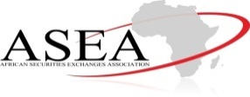
THANK YOU FOR YOUR ATTENTION

