Slide 1
Towards A New Economic Union
A Twenty First Century Hanseatic League?
Professor Michael Mainelli
@mrmainelli
michael_mainelli@zyen.com
10 November 2016, London

Slide 2
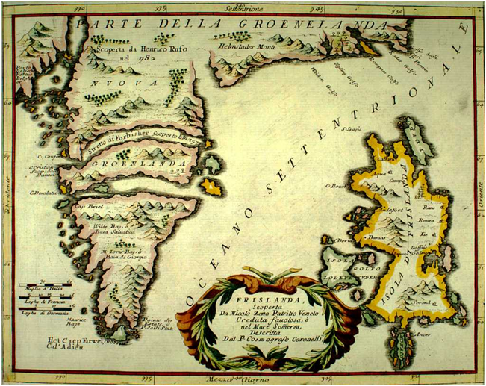
Outline
Surveying the global financial centre landscape
Hanseatic inspirations
BREXIT challenges

Slide 3
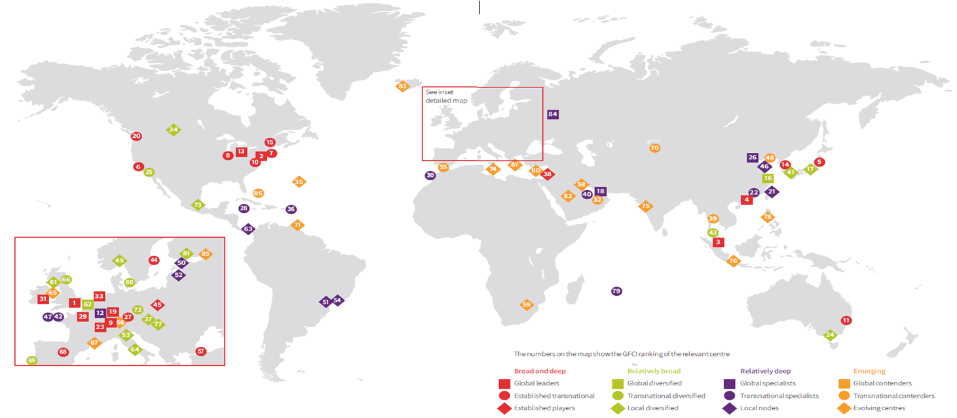
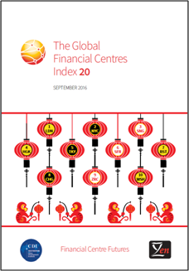
GFCI World

Slide 4
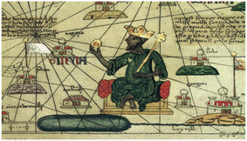
Why Study Financial Centres?
Vibrant, competitive financial centres give cities economic advantages in information, knowledge and access to capital
Being part of the global financial network ensures cities gain from global trade and growth
Policy decisions can create successful financial centres
[1375 Catalan Atlas of the known world (mapamundi), drawn by Abraham Cresques of Mallorca]
Notes:
4

Slide 5
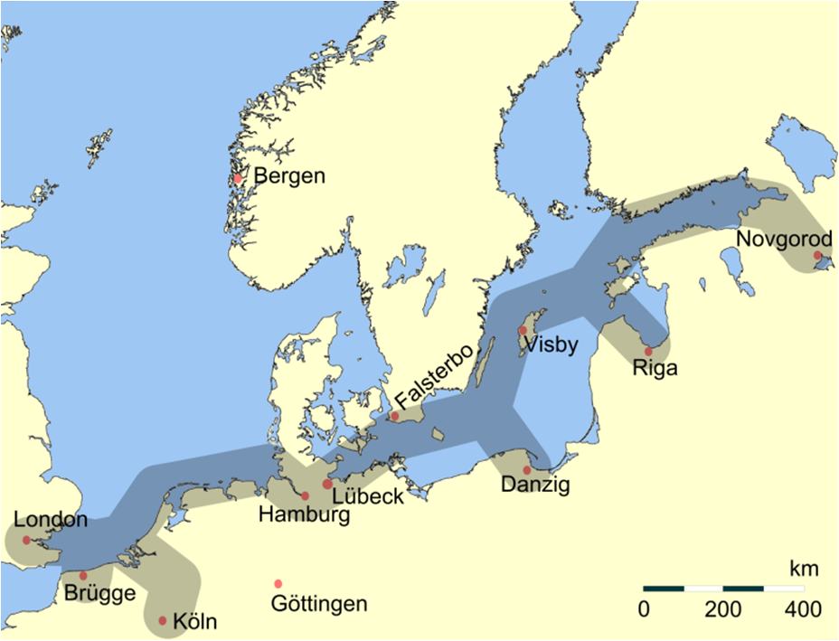
Read My Lips… Trade

Slide 6
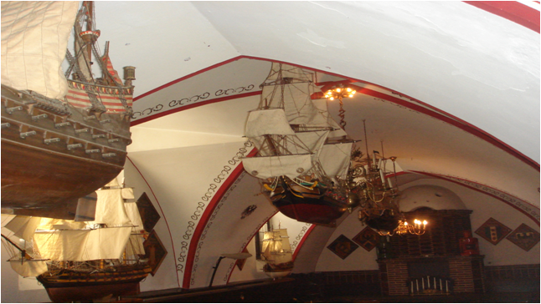
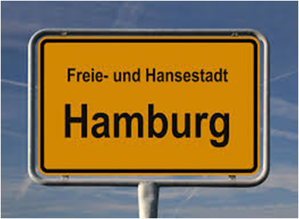
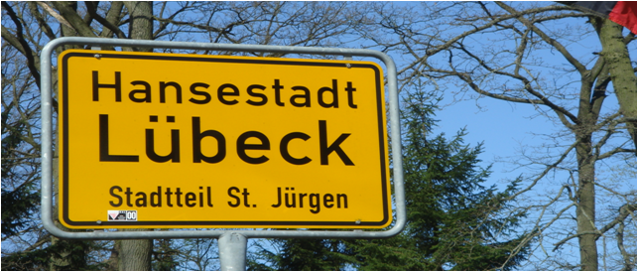
Mythical Influence

Slide 7
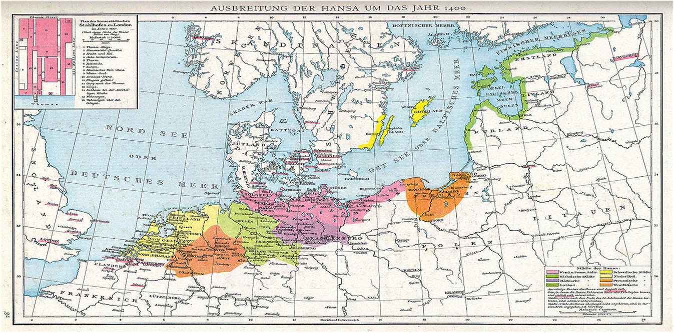
Hanseatic World

Slide 8
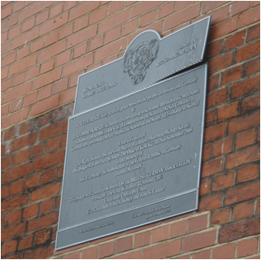
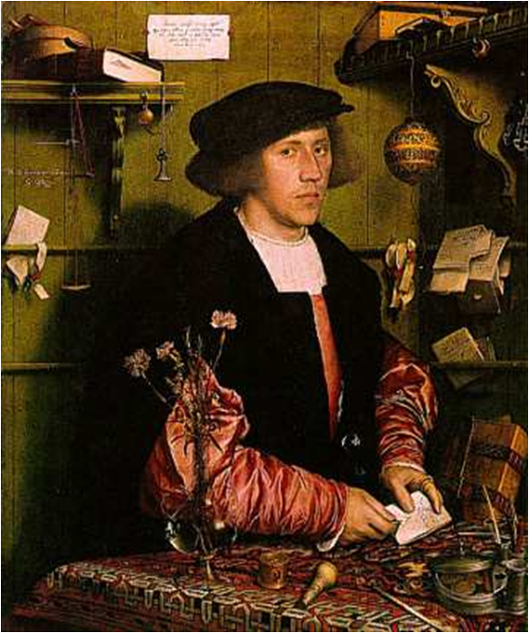
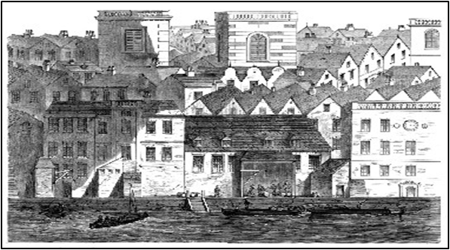
Hanseatic Inspirations
Danziger Hansekaufmann
Georg Gisze
Hans Holbein der Jüngere, London 1532

Slide 9
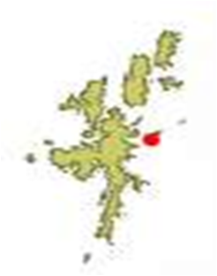
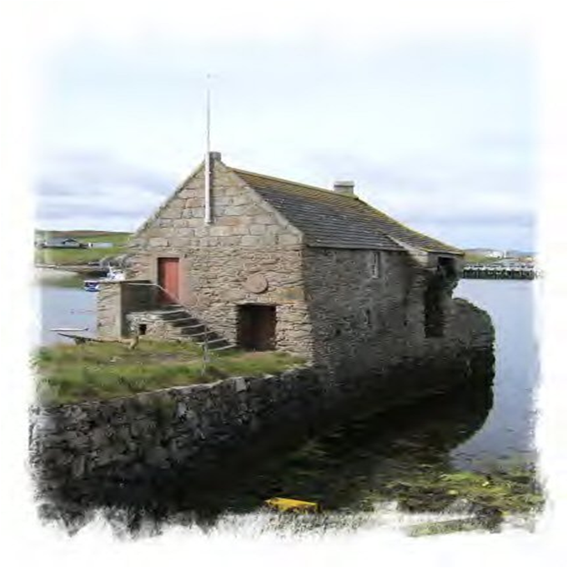
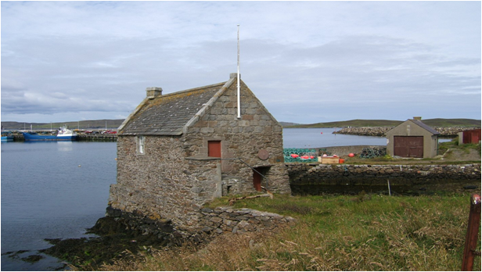
Hanseatic Cautions

Slide 10
Lessons
You can’t be an international business centre without international people
International people want to live in successful, cosmopolitan cities
Successful cosmopolitan cities live on their reputation

Slide 11
London As A BREXIT Financial Centre
Essentials
EU nationals
Passporting
GDPR – General Data Protection Regulation
New London of the ‘Radical Centre’?
‘Open for business’ - rethink AML/KYC/UBO and tax
‘Placing business’ – working with others - regulation as a competitive service
‘Safe for business’ - Cyber insurance and reinsurance

Slide 12
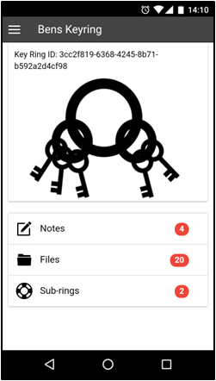
A New League?
City visas?
City financial service business passports’ – “keys to the cities”?
Reciprocal KYC/AML/UBO arrangements?
Reciprocal and umbrella regulatory arrangements?

Slide 13
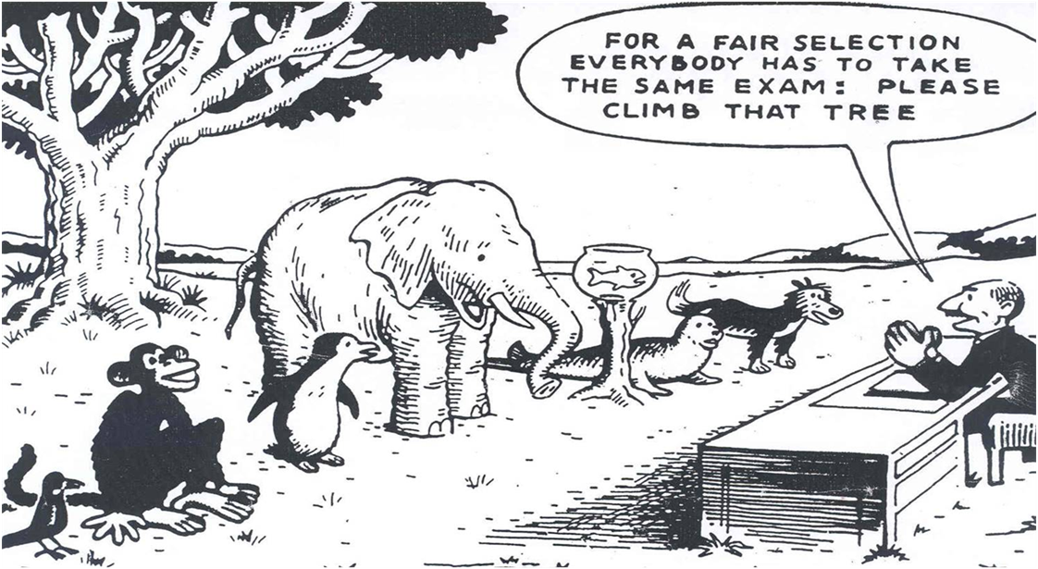
One True Strategy For Success
“Treat All Comers Fairly”

