Slide 1
The Global Financial Centres Index
Mark Yeandle FCIM MBA

Slide 2
Z/Yen
Special – City of London’s leading think-tank and research house
Services – projects, coaching/training, expertise on demand, research
Sectors – technology, finance, voluntary, professional services, outsourcing
British Computer Society IT Director of the Year for PropheZy and VizZy
DTI Smart Award for PropheZy
Sunday Times Book of the Week, Clean Business Cuisine
£1.9M Foresight Challenge Award for Financial £aboratory visualising financial risk

Slide 3
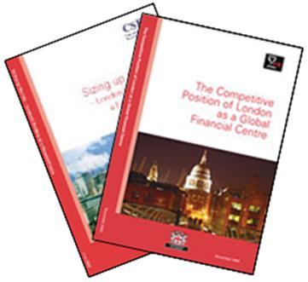
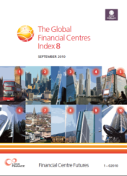
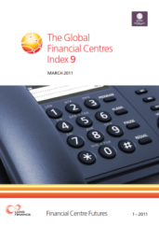
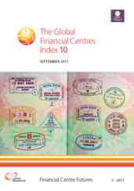
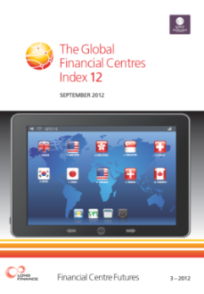
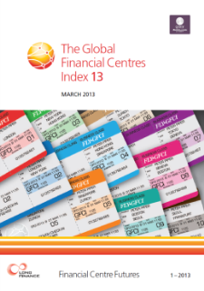
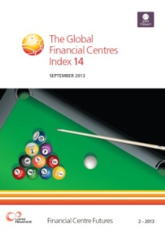
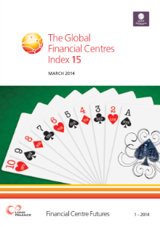
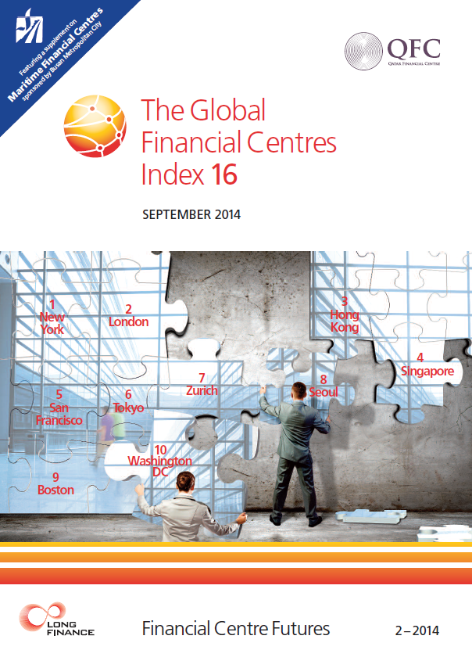
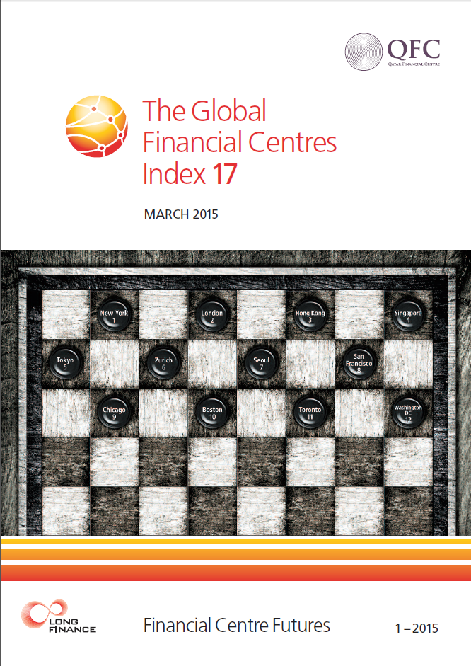
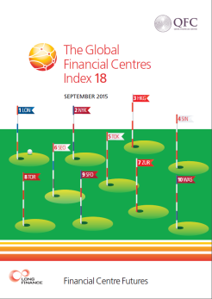
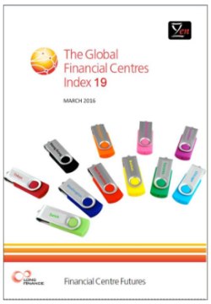
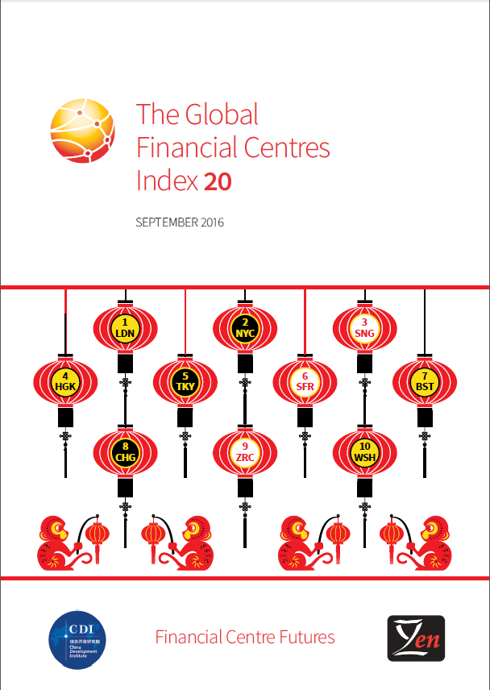
Z/Yen Financial Centres Research

Slide 4
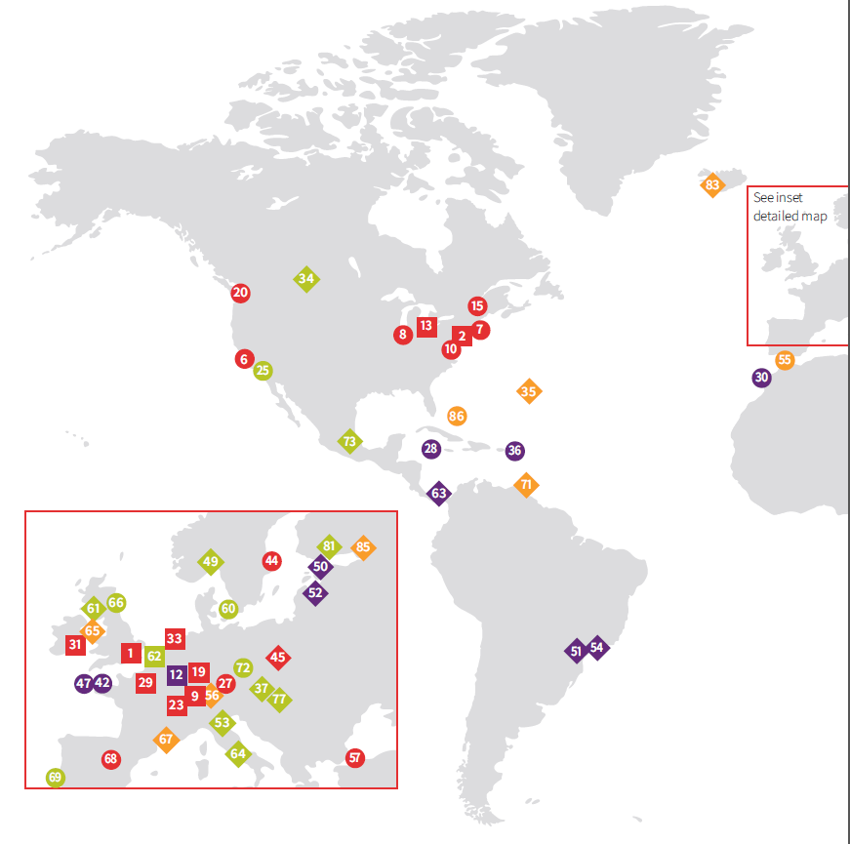
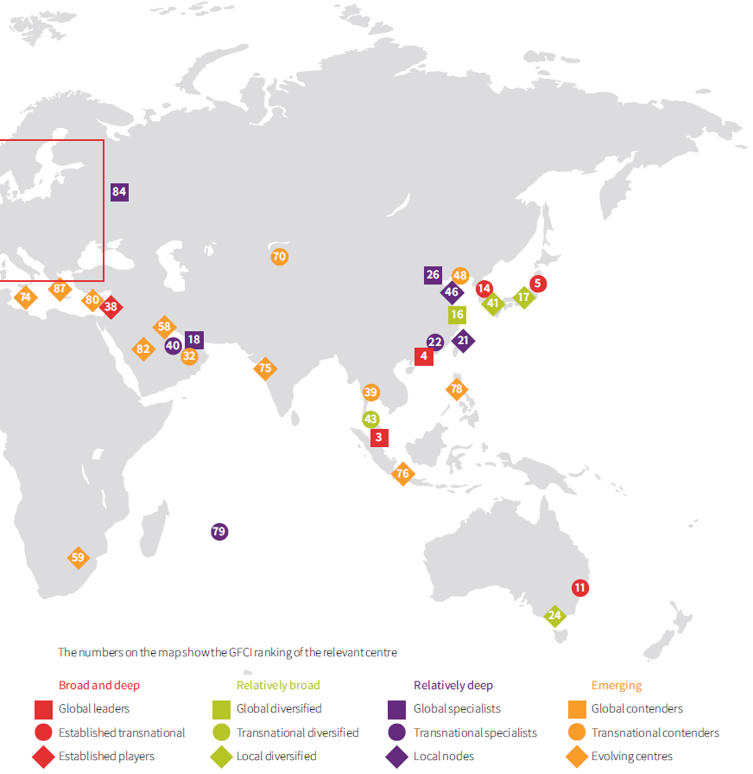
THE GFCI World

Slide 5
A Global Phenomenon

Slide 6
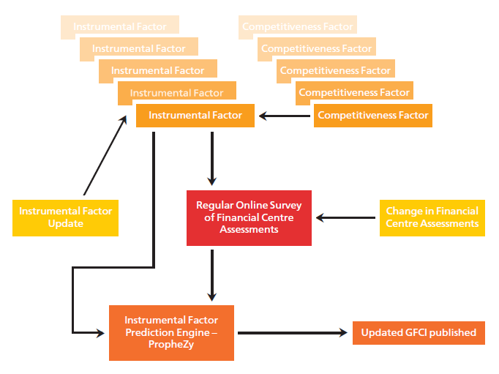
The GFCI Process
GFCI 20 uses 101 Instrumental Factors
GFCI 20 uses 23,006 assessments from 2,493 respondents

Slide 7
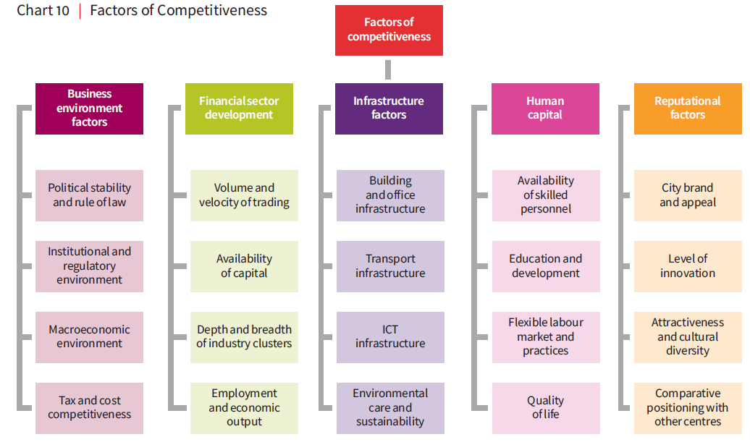
Multi-Factor Financial Centres

Slide 8
Headline Findings
Europe - London, Zurich, Luxembourg, Frankfurt and Geneva are now the top five in Europe. Luxembourg and Frankfurt see rises. Results were downloaded before Brexit result affected them.
Asia – Hong Kong, Singapore and Tokyo continue to lead the way. Seoul makes up a lot of ground and Sydney grows in importance.
North America – All North American centres (except Calgary) went up in the ratings in GFCI 20. San Francisco and Boston – both successful FinTech. Chicago enters the top ten. Toronto, the leading Canadian centre, is now 13th.
Latin America & Caribbean – Generally made up some ground. Sao Paulo, Rio de Janeiro and Mexico continue to struggle. Sao Paulo remains the top Latin American centre in GFCI 20, despite falling eight places. Trinidad and Tobago have entered the index for the first time in 71st place.
Middle East & Africa – Except for Bahrain which saw a modest rise, all Middle Eastern centres were down. Dubai only fell by a single point and remains ahead of other regional centres. With the exception of Casablanca, the African centres also declined.
Offshore – most make up some lost ground. Cayman Islands, Bermuda and BVI ahead of Channel Islands

Slide 9
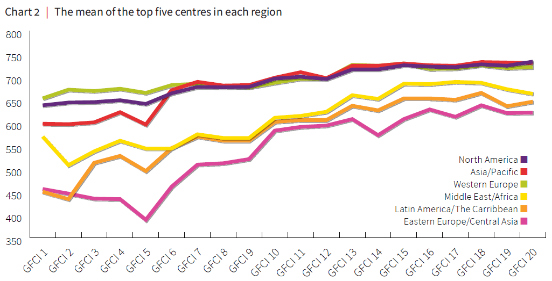
The Top Five Regions
The mean of the top five centres by region. North America and Western Europe are now behind Asia/Pacific.

Slide 10
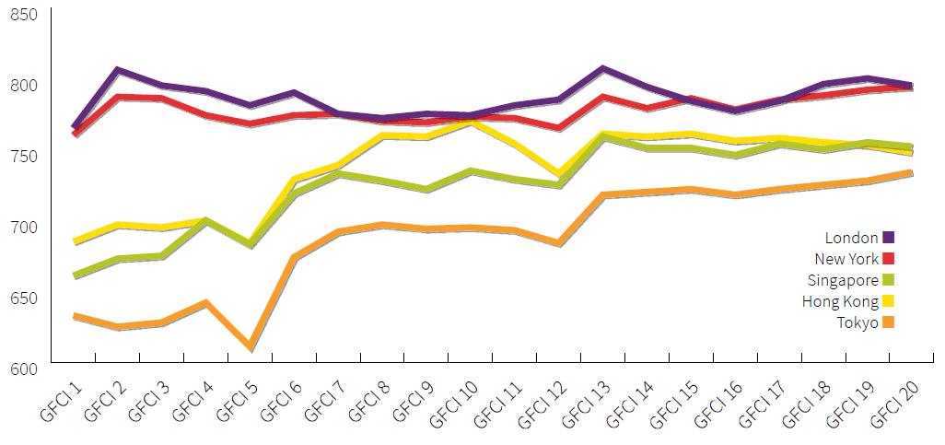
The Top Five Centres
New York, London, Hong Kong, and Singapore remain the four leading global financial centres. Tokyo, in 5th place, is now only 14 points behind Singapore.

Slide 11
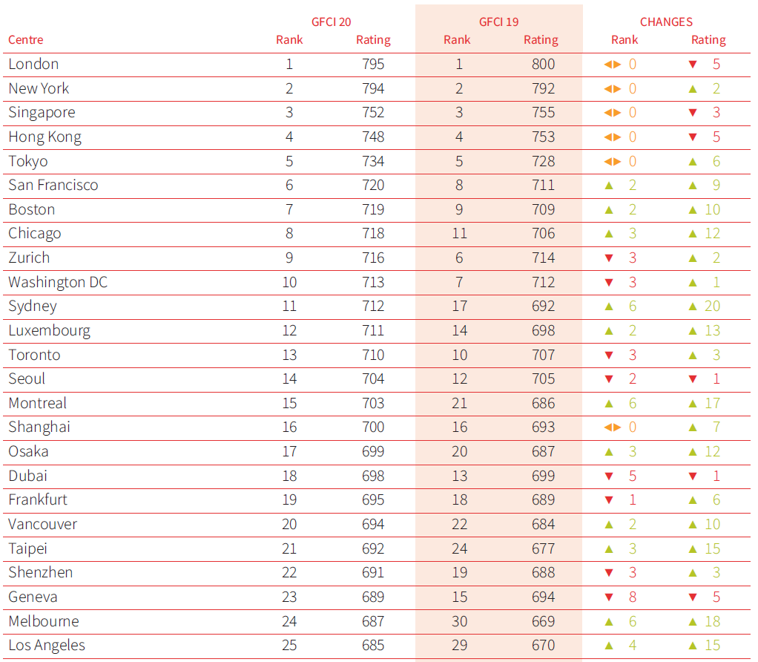
The Top 20

Slide 12
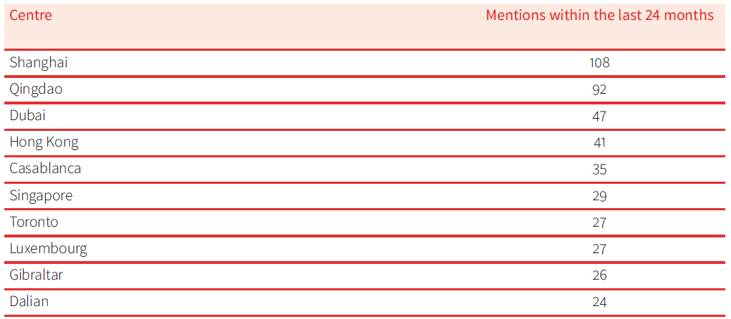
Greater Significance?
Five of the Top Ten are Asian

Slide 13
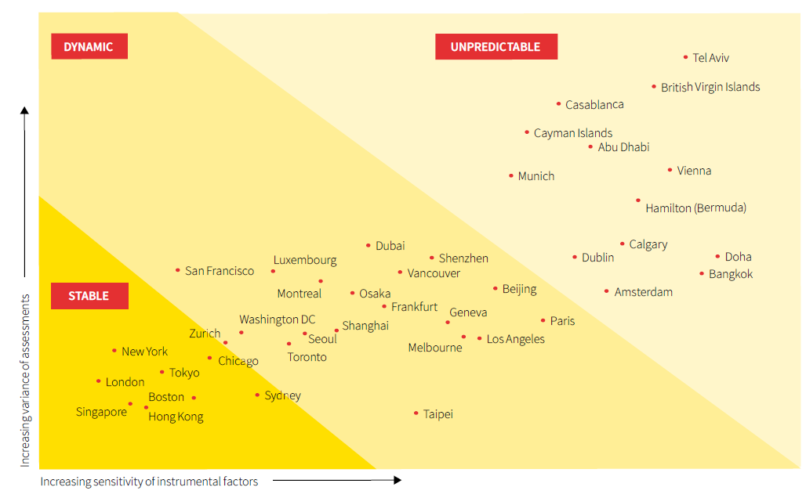
Stability

Slide 14
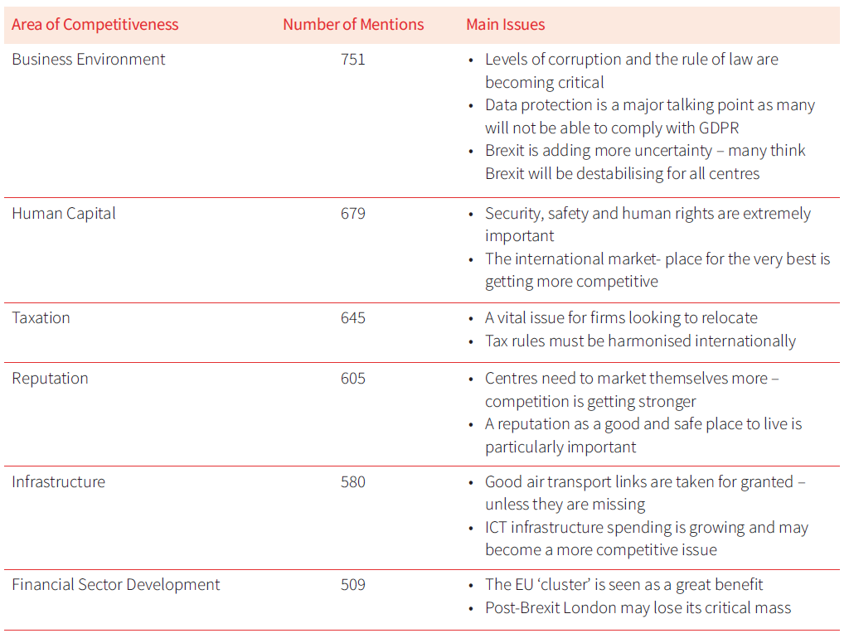
What’s on Peoples’ Minds

Slide 15
Do’s and Don’ts
Do
Work together with others
Act to provide financial conduits
Act for the long term
Increase transparency wherever possible
Continue to demonstrate commitment to international standards
Continue to demonstrate skill levels and specialisations
Publicise benefits and functions
Don’t
Be secretive or Help tax evaders
Think Win / Lose
be deliberately unhelpful to the international community

Slide 16
Five Truths about Financial Centres
You can’t be an international centre without international people
Successful people want to live in successful places
People want to live in cosmopolitan places and gravitate to clusters
Reputation is vital:
“It takes 20 years to build a reputation and five minutes to ruin it.”
Trust is “the glue that holds all relationships together”

Slide 17
GFCI 21 – March 2017
Trump as US President?
Brexit Negotiations?
World GDP Growth?
Chinese Developments?
Participate yourself at:
www.financialcentrefutures.net

