Slide 1
Mutual distributed ledgers and financial crime

Slide 2
Agenda
Growing dangers of Financial Crime
Know your customer utilities and managed services and what PwC is doing in this space
How we are using mutual distributed ledger technology as part of our solution

Slide 3
Financial crime costs the world economy $2 trillion a year
Financial services firms are on the front line of defence but have been heavily fined over recent years….
$8.9bn
Sanctions fine – BNP Paribas
$1.9bn
$2.6bn
AML – HSBC
Tax evasion – Credit Suisse
$2.5bn
$1.5bn
LIBOR – Deutsche Bank
Commerzbank
$1.5bn
$3mn
LIBOR – UBS
AML – SCB

Slide 4
Key challenges to combating financial crime
More regulation
Advances in technology
Sophisticated criminals
Operational silos - not looking at financial crime holistically
Not knowing who the customer is
Not understanding customers’ transactions

Slide 5
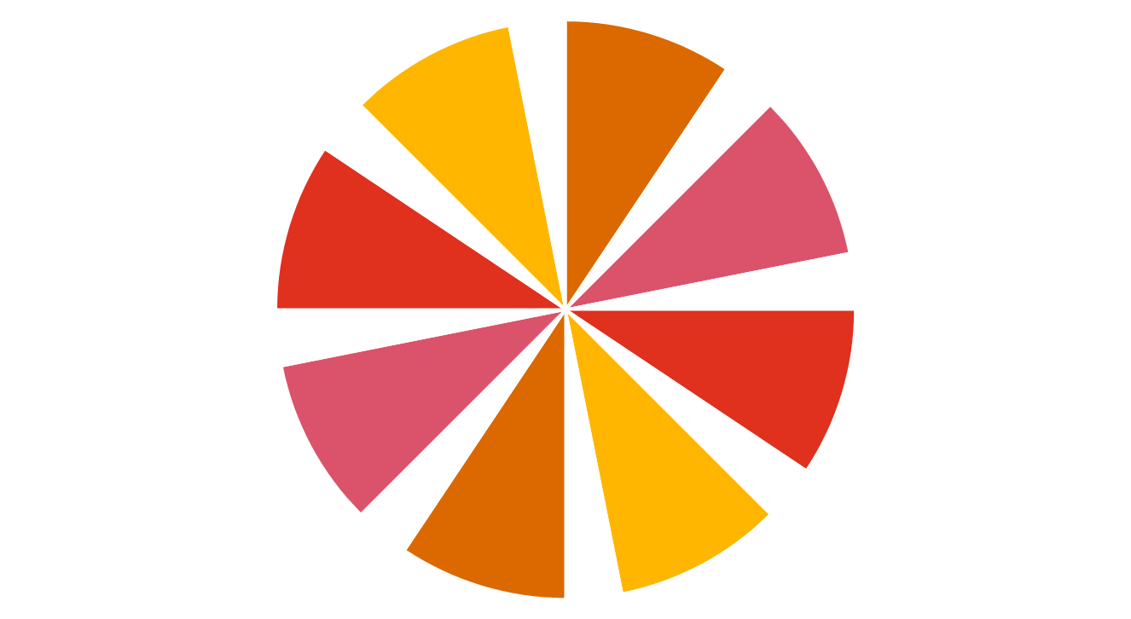
Financial crime framework
Technology
Financing terrorism
Holistic approach
Overlaid with technology
Collaboration amongst industry participants
Increasing move towards utilities
Sanctions
Fraud & dishonesty
Handling the proceeds of crime
Technology
Technology
Financial Crime
Bribery & corruption
Market abuse
Tax evasion & tax fraud
Technology
Cyber related

Slide 6
Know Your Customer utility – definition
Customers
PwC has launched the PwC KYC utility - a managed service activity that streamlines the collection, verification, storage and sharing of data amongst participating FIs.
It is a technologically enabled solution that helps FIs to perform KYC checks once and do it to the highest standard thus removing the duplication from the process.
KYC Utility
FIs

Slide 7
Know Your Customer utility development Clear regulatory, economic and social benefits to be achieved
Past
Current position
Long term shared utility
Customers
Utility 1
Utility 2
KYC Utility
Financial institutions

Slide 8
What does a utility do?
Identification and verification checks
Screening
PEPs
Sanctions
Negative News
Results filtering
Refresh of existing clients
1
2

Slide 9
The process
1
2
3
4
5
Profile initiation by FI and submission
Matching against existing records (if relevant)
Due diligence and screening
Core due diligence pack sent to FI
Finalisation of due diligence and onboarding decision
Client
FI
Verification report
Screening result
False positive hit
Positive, not relevant
PEP identified
Bad press positive hit
Identification and verification
FI
✓
Results
Bad press screening
Results
✓
ID
Bernard Lawrence Madoff
Driving license
http://www.forbes. pl/tagi/8/bernard-madoff/1
Completed profile
Identification and verification
Screening against sanctions/PEPs
Bad press screening
Bernard Lawrence Madoff
✓
✓
✓
Example only for discussion purposes
Centre of excellence
In accordance with regulatory and other requirements the responsibility for customer onboarding remains with financial institutions.

Slide 10
What are the benefits?
Quicker and more efficient client onboarding
An improved customer experience
Scale economies for all through utility data sharing
Reduced cost of KYC compliance
KYC as a core competency for a central utility
Significant reduction in regulatory visits
Common KYC standards
Optimal KYC effectiveness
Jurisdictional reputation enhanced
PwC

Slide 11
Mutual distributed ledgers have a role to play in fighting financial crime

Slide 12
Practical data related challenges
Accessibility
Ownership
Transparency
Confidentiality
Data security and integrity
Audit trails

Slide 13
Potential advantages of Mutual Distributed Ledgers (MDLs)
Data can never be deleted, but access life can be controlled
Robust and unalterable audit trail
Potentially attractive security features (encryption, hashing, distributed nature of the network)
Data ownership can be tailored to individuals and corporates with the help of public/private keys
Data transparency potentially facilitates compliance with EU GDPR rules
MDL facilitates other use cases such as digital identity and UBO registries.

Slide 14
Key data security features within a MDL environment
Public/private key Ensures confidentiality
Hashing Validates integrity
Peer-to-peer network Provides enhanced data security
Bob
Hello Alice!
Encrypt
Alice’s public key
6EB69570 08E03CE4
=
79054025
155fb1a2
6e4bc422
aef54eb4
Alice
Hello Alice!
Decrypt
Alice’s private key
P2P – network

Slide 15
Applying MDL technology to the PwC KYC utility Potentially a move towards digital identities
1. Customer provides KYC data to the PwC utility
Customer
1. Customer provides KYC data to the utility
PwC centre of excellence
2. The PwC utility validates, reviews and adds data to the MDL
Local
Offshore
Mutual distributed ledger
MDL
Standard due diligence
Enhanced due diligence
3. Eligible third parties trust that the data is legitimate as verified and input by the PwC utility
Customer
4. Customer can grant secure access to their KYC data to desired third parties
FIs, individuals

Slide 16
MDL architecture options
Access and visibility
Adding a transaction
Authorising a transaction
Semi private ledger
Private ledger
Public ledger
Only restricted person can add data
Several authorised people can add data to provide checks and balances
Anyone can add data
One authorising party
Several parties authorising
Several authorising parties
Complete trust in the central third party
No trust in the central third party

Slide 17
Conclusions
Know your customer utilities and MDL have a role to play in preventing and detecting financial crime
MDLs provide a unique way of capturing and retaining KYC and other identity data as well as an unalterable audit trail
These innovations might help in a move towards individuals owning their own digital identity and potentially a move towards e-government
Finally, they help to meet our purpose of building trust

Slide 18
Thank you
This publication has been prepared for general guidance on matters of interest only, and does not constitute professional advice. You should not act upon the information contained in this publication without obtaining specific professional advice. No representation or warranty (express or implied) is given as to the accuracy or completeness of the information contained in this publication, and, to the extent permitted by law, PricewaterhouseCoopers LLP, its members, employees and agents do not accept or assume any liability, responsibility or duty of care for any consequences of you or anyone else acting, or refraining to act, in reliance on the information contained in this publication or for any decision based on it.
© 2016 PricewaterhouseCoopers LLP. All rights reserved. In this document, "PwC" refers to the UK member firm, and may sometimes refer to the PwC network. Each member firm is a separate legal entity. Please see www.pwc.com/structure for further details.
161004-145705-DN-UK

