Slide 1
BRVM INVESTMENT DAYS
Amine Bouabid – BOA GROUP CEO
London, May 2018

Slide 2
Agenda
Part I. BOA GROUP OVERVIEW
  Structure of BANK OF AFRICA Group
  BOA GROUP’s identity card
  BOA GROUP’s role
  BOA GROUP’s main figures evolution
  BOA GROUP’s main figures as of December 2017
PART II. Focus on BOA’s subsidiaries listed on BRVM
  BRVM 2017 overview
  Focus on BOA’s listed banks in Abidjan
  BOA BENIN overview
  BOA BURKINA FASO overview
  BOA COTE D’IVOIRE overview
  BOA MALI overview
  BOA NIGER overview
  BOA SENEGAL overview

Slide 3
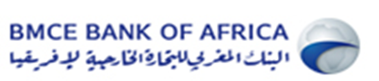
BANK OF AFRICA Group structure
BMCE Bank of Africa
  BMCE Bank of Africa, is the 2nd largest commercial bank in Morocco
  BMCE Bank’s Total asset as of December 2017 amounts EUR 28,5 Billions and its consolidated equity stands at EUR 1,7 Billions.
Based on 1 EUR = 11 MAD
73%
  BOA Group is a Luxembourgian holding
  BOA Group’s Total asset as of 2017 amounts EUR 7,7 Billions, with EUR 3,9 Billions of Customer loans.
  BOA GROUP’s consolidated equity stands at EUR 536 Millions.
  WAEMU subsidiaries (banks) are under BOA WEST AFRICA umbrella, a regulated entity based in Ivory Coast and controlled by BOA GROUP (100%)
BOA GROUP
> 51%
  The Group is present in 17 Sub-Saharan countries and in France where it controls the majority of the stakes and manage the subsidiaries.
  Our subsidiaries are located in the WAEMU zone, in the East-African Community zone, in DRC, Madagascar and Djibouti.
BOA Benin
BOA …
BOA Sénégal
BOA Kenya

Slide 4
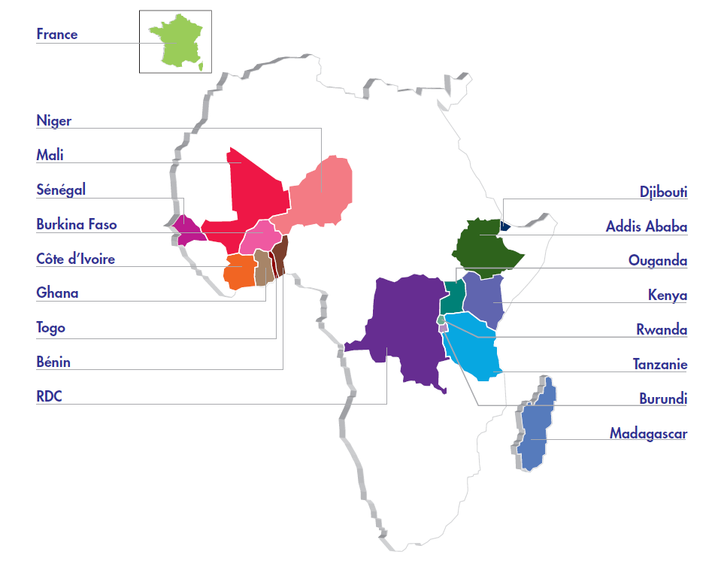
BOA GROUP’s identity card
Group presence
BOA Group shareholders as of Decembre 2017

Slide 5
BOA GROUP’s role
BOA SERVICES based in Dakar, supervises, controls and monitors banks’ activities, in terms of:
Strategy definition
IT & Process
Financial performance monitoring
BOA SERVICES accounts 150 persons
and 15 nationalities
Treasury support
Risks monitoring
Economy of scale matter
Digital & Marketing
Compliance, AML, Audit control
Human Resources
Notes:
Strategy design
Performance monitoring
IT process
Treasury support
Human resources
Risk monitoring
…

Slide 6
BOA GROUP’s main figures growth (2013-2017)
Total Balance sheet (MEUR)
Customer loans (MEUR)
Customer deposits (MEUR)
+12 % AGG
+12 % AGG
+11 % AGG
Net Operating Income (MEUR)
Net Income Group’s share (MEUR)
+10 % AGG
+ 25 % AGG
%
Average annual growth
(2013-2017)

Slide 7
BOA GROUP’s main figures as of December 2017
EUR Million | 2017 | Annual variation
Total Asset | 7 659 | -2,0%
Customer loans | 3 930 | +3,0%
Customer deposits | 5 180 | +3,4%
Equity Group share | 536 | +2,9%
Net Banking Income | 473 | +0,7%
Net Income | 125 | +10,6%
Net Income Group share | 76 | +13%
Cost to income ratio | 64,9%
Cost of risk | 1,16%
NPL ratio | 10,4%
Provision / NPL | 67,9%
ROE | 14,4%
ROA | 1,0%
More than 5 600 employees and 500 branches
Over 3 millions customers
Consolidated figures

Slide 8
Contribution of BOA GROUP’s subsidiaries in average RWA and aggregated Net income
Regional footprint of Bank of Africa
(France excluded)
Average Risk Weighted Asset contribution per area (2017)
Group aggregated Net income contribution per area (2017)
WAEMU
Western Africa subsidiaries represent 66% of the Group total average Risk Weighted asset and contribute to 73% of the Group aggregated Net income.
Our subsidiaries in Indian Ocean are the most profitable, representing 17% of total average RWA for 22% contribution in the aggregated Net income.
Indian Ocean
(Madagascar & Djibouti)
English speaking countries
Central Africa (DRC & Burundi)
Figures based on FX of all currencies converted to EUR, as of December 2017

Slide 9
Agenda
Part I. BOA GROUP OVERVIEW
  Structure of BANK OF AFRICA Group
  BOA GROUP’s identity card
  BOA GROUP’s role
  BOA GROUP’s main figures evolution
  BOA GROUP’s main figures as of December 2017
PART II. Focus on BOA’s subsidiaries listed on BRVM
  WAEMU bonds market overview
  BRVM capital market 2017 overview
  Focus on BOA’s listed banks in Abidjan
  BOA BENIN overview
  BOA BURKINA FASO overview
  BOA COTE D’IVOIRE overview
  BOA MALI overview
  BOA NIGER overview
  BOA SENEGAL overview

Slide 10
West Africa Bonds market overview
Market main figures as of April 2018
Challenges to overcome
  No fiscal harmonisation : different taxation levels according to the type of bond issued, the issuing country, the subscriber country,..
  → Taxes variation for the subscriber between 2% and 15%
  Complexity of the market : several types of obligations (with periodical coupon, amortised or in fine, sukuks,..)
  Important level of fee (up to 40 bps, excluding asset management companies fee)
  Long process to issue bonds, depends on regulators commissions
  Rating mandatory
  Public offering → Require at least 100 investors
  Private placing → Maximum amount of XOF 10 Billion (EUR 15 Millions)
In EUR Million | Outstanding amount | 2018 Issuing
Gov’t bonds | 14 687 (*) | 1 240
Private bonds (public market) | 427 | 7,6
(*) Only 31% of the outstanding amount on the BRVM (69% through Central Bank)

Slide 11
BRVM capital market 2017 overview
BRVM total market capitalization amounts about EUR 10,4 Billion (XOF 6 836 Billion) as of December 2017, with 45 companies.
The average volume exchanged in 2017 is 361 830 shares per day ( ≈ 1-2 Million € /day) , with almost 70% of the volume done by the finance industry.
  → Low liquidity
  → New regulation aiming to increase the number of shares and the part of float (implemented in 2017 for BOA)
BRVM’s capitalization breakdown as of December 2017
Industry | Number of companies | 2017 performance | % of market capitalization | 2017 PER
INDUSTRY | 12 | -34,36% | 7,6% | 22,22x
PUBLIC SERVICES | 4 | -10,86% | 41,6% | 13,74x
FINANCES | 14 | -10,46% | 36,0% | 11,61x
TRANSPORTATION | 2 | -16,01% | 4,0% | 26,83x
AGRICULTURE | 5 | -15,64% | 4,1% | 23,99x
DISTRIBUTION | 7 | -43,34% | 6,6% | 17,07x
OTHERS | 1 | -48,60% | 0,0% | 2,17x
TOTAL | 45 | -16,81% | 100,0% | 17,29x*
* Source Bloomfield – does not take into account companies in liquidation

Slide 12
Focus on BOA’s listed banks in Abidjan
Six BANK OF AFRICA’s subsidiaries are listed on the BRVM regional stock exchange, which are, in order of listing: BOA-BENIN (2000), BOA-NIGER (2003), BOA-CÔTE D’IVOIRE (2010), BOA-BURKINA FASO (2010), BOA-SENEGAL (2014) and BOA-MALI (2016).
On an aggregated basis, the market capitalization of the 6 banks amounts EUR 894 Million (XOF 586 Billion) as of March 2018. BOA’s subsidiaries represent 25% of the finance industry total market capitalization.
Free-float represents between 30% and 40% of the capital of each listed bank.
BOA banks main performances
 | 2017 performance | Dividend Yield 2017 | Dividend Yield March 2018 | Net income 2017 growth | 2017 PER
BOA BENIN | -11,3% | 6,5% | 6,5% | -8,2% | 10,1x
BOA BURKINA FASO | 2,5% | 5,5% | 5,9% | 21,1% | 10,4x
BOA COTE D’IVOIRE | -29,5% | 6,2% | 6,5% | 6,9% | 9,0x
BOA MALI | -2,5% | 7,7% | 7,3% | -20,0% | 10,7x
BOA NIGER | -28,5% | 8,2% | 8,2% | 10,4% | 8,8x
BOA SENEGAL | 6,4% | 2,2% | 6,1% | 149,6% | 5,9x
2017 performance
BRVM | -16,8%
Finance industry | -10,5%

Slide 13

BOA BENIN overview
BOA - BENIN
Financial performances
Market performances
XOF Million | déc-16 | déc-17 | var
Total Asset | 932.977 | 974.544 | 4,5%
Customer loans | 334.669 | 398.148 | 19,0%
Customer deposits | 538.994 | 539.608 | 0,1%
Net operating income | 39.335 | 39.608 | 0,7%
Net income | 16.139 | 14.814 | -8,2%
ROE | 24,0% | 20,1%
ROA | 1,8% | 1,6%
Market capitalization: XOF 135 Billion (MEUR 206)
Average volume exchanged per month: 11 600 shares
 | déc- 17 | mar-18
Closing price (XOF) | 7.450 | 6.700
Price performance | -11,3% | -10,1%
Dividend yield ^{(*)} | 6,5% | 6,5%
Total performance | -4,9% | -3,5%
PER | 10,1x | 9,1x
P/B Ratio | 2,0x | 1,8x
(*) Dividend Year N-1 / Closing stock price Year N

Slide 14

BOA BURKINA FASO overview
BOA – BURKINA FASO
Financial performances
Market performances
XOF Million | déc-16 | déc-17 | var
Total Asset | 714.127 | 757.165 | 6,0%
Customer loans | 372.418 | 422.019 | 13,3%
Customer deposits | 430.312 | 523.829 | 21,7%
Net operating income | 33.685 | 37.041 | 10,0%
Net income | 12.443 | 15.062 | 21,1%
ROE | 27,2% | 29,6%
ROA | 1,8% | 2,0%
Market capitalization: XOF 151,8 Billion (MEUR 231)
Average volume exchanged per month: 6 310 shares
 | déc- 17 | mar-18
Closing price (XOF) | 7.150 | 6.900
Price performance | 2,5% | -3,5%
Dividend yield ^{(*)} | 5,5% | 5,9%
Total performance | 8,0% | 2,4%
PER | 10,4x | 10,1x
P/B Ratio | 2,6x | 2,5x
(*) Dividend Year N-1 / Closing stock price Year N

Slide 15

BOA COTE D’IVOIRE overview
BOA – COTE D’IVOIRE
Financial performances
Market performances
XOF Million | déc-16 | déc-17 | var
Total Asset | 623.026 | 642.538 | 3,1%
Customer loans | 294.326 | 341.664 | 16,1%
Customer deposits | 342.367 | 403.044 | 17,7%
Net operating income | 29.007 | 30.426 | 4,9%
Net income | 10.150 | 10.845 | 6,8%
ROE | 28,7% | 27,4%
ROA | 1,7% | 1,7%
Market capitalization: XOF 99,7 Billion (MEUR 152 )
Average volume exchanged per month : 10 844 shares
 | déc- 17 | mar-18
Closing price (XOF) | 4.900 | 4.985
Price performance | -29,5% | 1,7%
Dividend yield ^{(*)} | 6,2%
Total performance | -23,3%
PER | 9,0x | 9,2x
P/B Ratio | 2,3x | 2,4x
(*) Dividend Year N-1 / Closing stock price Year N

Slide 16

BOA MALI overview
BOA - MALI
Financial performances
Market performances
XOF Million | déc-16 | déc-17 | var
Total Asset | 514.000 | 457.396 | -11,0%
Customer loans | 262.183 | 262.121 | -4,9%
Customer deposits | 313.939 | 327.425 | 4,3%
Net operating income | 29.747 | 29.785 | 0,1%
Net income | 9.403 | 7.526 | -20,0%
ROE | 25,9% | 19,4%
ROA | 1,8% | 1,5%
Market capitalization: XOF 65,6 Billion (MEUR 100)
Average volume exchanged per month : 8 339 shares
 | déc- 17 | mar-18
Closing price (XOF) | 5.200 | 4.250
Price performance | -2,5% | -18,3%
Dividend yield ^{(*)} | 7,7% | 7,3%
Total performance | 5,2% | -10,9%
PER | 10,7x | 8,7x
P/B Ratio | 2,0x | 1,7x
(*) Dividend Year N-1 / Closing stock price Year N

Slide 17

BOA NIGER overview
BOA - NIGER
Financial performances
Market performances
XOF Million | déc-16 | déc-17 | var
Total Asset | 286.746 | 294.499 | 2,7%
Customer loans | 164.236 | 170.037 | 3,5%
Customer deposits | 145.332 | 157.532 | 8,4%
Net operating income | 19.087 | 19.626 | 2,8%
Net income | 6.600 | 7.284 | 10,4%
ROE | 24,7% | 25,5%
ROA | 2,4% | 2,5%
Market capitalization: XOF 64,7 Billion (MEUR 99)
Average volume exchanged per month: 13 682 shares
 | déc- 17 | mar-18
Closing price (XOF) | 4.950 | 4.980
Price performance | -28,5% | 0,6%
Dividend yield ^{(*)} | 8,2% | 8,2%
Total performance | -20,3% | 8,8%
PER | 8,8x | 8,9x
P/B Ratio | 2,1x | 2,1x
(*) Dividend Year N-1 / Closing stock price Year N

Slide 18

BOA SENEGAL overview
BOA - SENEGAL
Financial performances
Market performances
XOF Million | déc-16 | déc-17 | var
Total Asset | 521.726 | 463.008 | -11,3%
Customer loans | 235.388 | 241.763 | 2,7%
Customer deposits | 318.797 | 272.766 | -14,4%
Net operating income | 21.985 | 25.301 | 15,1%
Net income | 4.051 | 10.114 | 149,6%
ROE | 14,6% | 30,0%
ROA | 0,9% | 2,1%
Market capitalization: XOF 69,7 Billion (MEUR 106)
Average volume exchanged per month: 8 660 shares
 | déc- 17 | mar-18
Closing price (XOF) | 2.500 | 2.900
Price performance | 6,4% | 16,0%
Dividend yield ^{(*)} | 2,2% | 6,1%
Total performance | 8,6% | 22,1%
PER | 5,9x | 6,9x
P/B Ratio | 1,6x | 1,8x
(*) Dividend Year N-1 / Closing stock price Year N

Slide 19
THANK YOU

